Slide 1
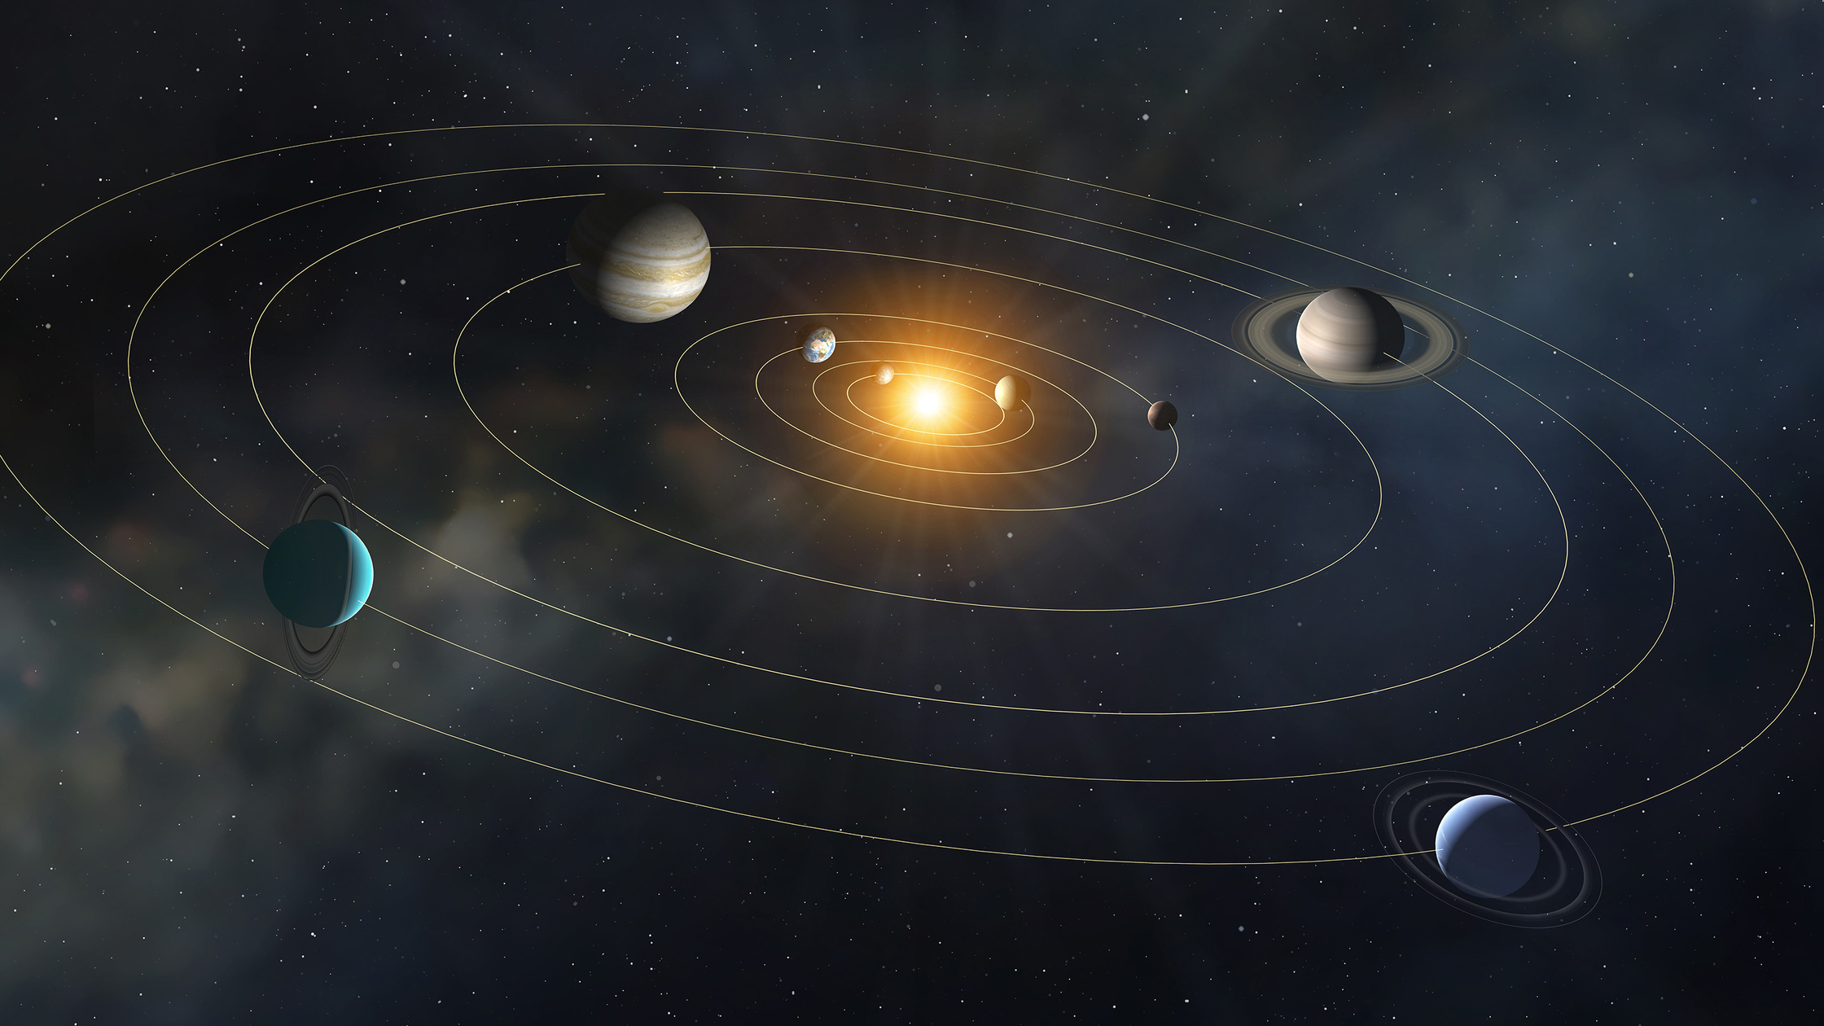

SOLARSHIELD PRESENTATION
By Team NanInSpace

Slide 2




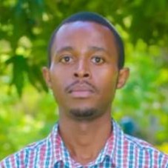

TEAM MEMBERS
Bismita Hazarika (IN)
Lynn Rose
(KE)
Ann Kandie
(KE)
Leonard Mwangi (KE)
Reuben Kariuki
(KE)

Slide 3
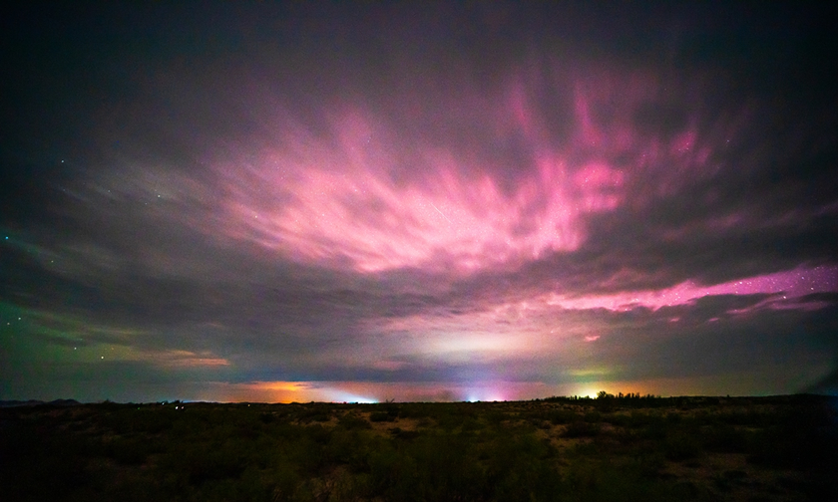
BACKGROUND
🚂 2000: Railways in Russia reported false blockages during a geomagnetic storm.
⚡ 2000: Power grids tripped in Alabama & Mississippi, USA.
🔌 2003: South Africa reported transformer failures during the “Halloween Storm.”
🚜 2024: UK storms disrupted power systems; farmers in Minnesota said tractors “acted demon possessed.”

Slide 4
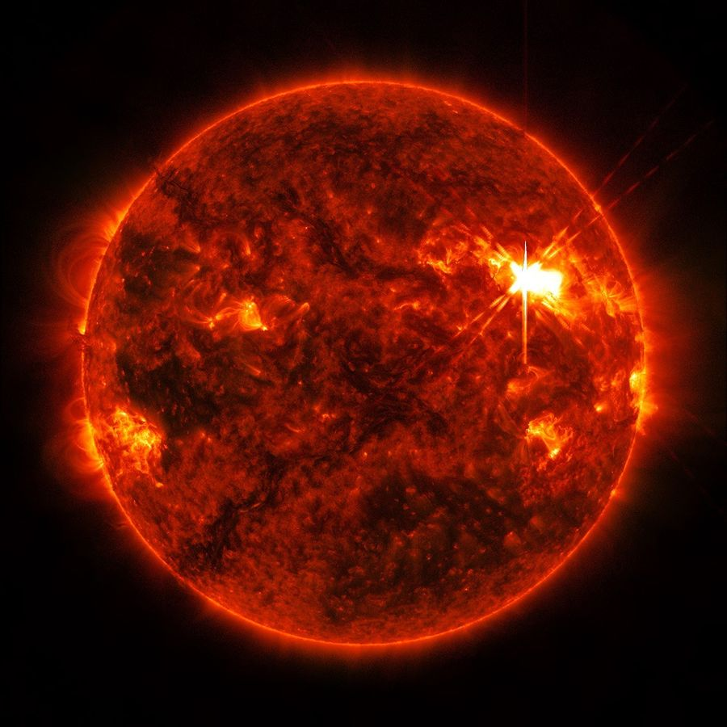
PROBLEM STATEMENT
Solar storms disrupt life on Earth
👨‍🌾 → GPS tractors fail → lost efficiency
🐟 → Navigation errors → higher risk at sea
📱 → Mobile money & networks fail without warning
The Gap
NASA & NOAA alerts = too technical
Communities left unprepared
NanInSpace: Turns complex data → simple, actionable insights

Slide 5
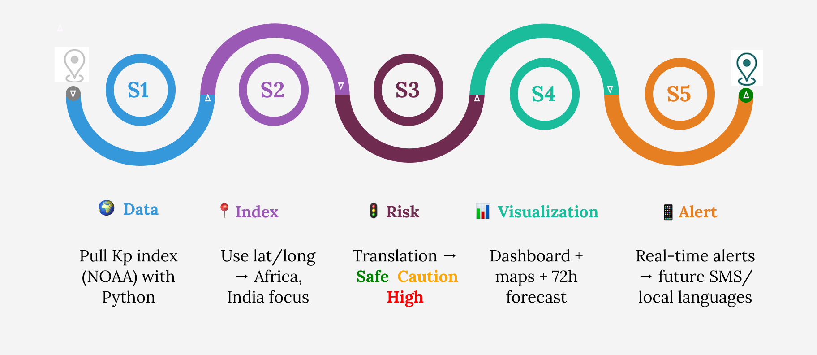
METHODOLOGY

Slide 6
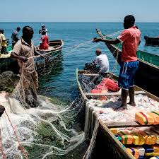
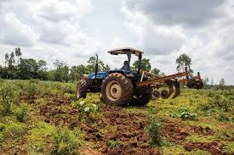
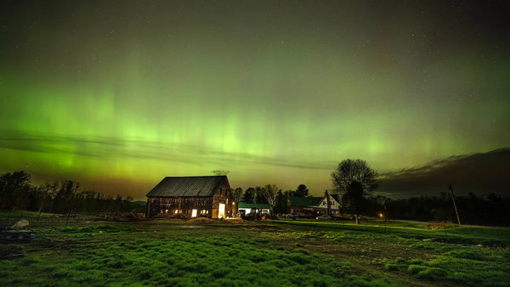

OUR SOLUTION – SOLARSHIELD
🟢🟡🔴 Simple risk levels (Safe | Caution | High Risk)
📊 Color-coded dashboard → clear like a weather app
👨‍🌾🐟📱 Community-friendly → farmers, fishermen, rural households
🌍 Future-ready → local languages, SMS/WhatsApp alerts, regional views

Slide 7
FROM DATA TO DAILY LIFE
https://geomagnetic-energy-risk-monitoring-system

Slide 8

LOOKING AHEAD
🌍 Regional Indices
Tailored risk levels for Africa, India & beyond
📱 Community Alerts
SMS / WhatsApp in local languages
🤝 Partnerships
With NGOs, governments & schools
🚀 Scalability
Expand SolarShield as a global early-warning system

Slide 9
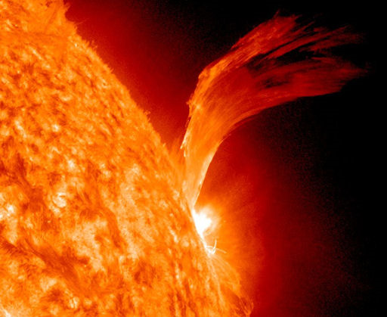



THANK YOU
Sources & Credits
Government of Canada, Space Weather Canada
PreventionWeb / UNDRR
Space.com
NOAA / NASA reports
Images courtesy of the United Nations & NASA
Data provided by NOAA Space Weather Prediction Center (SWPC)
https://geomagnetic-energy-risk-monitoring-system

